Slide 1
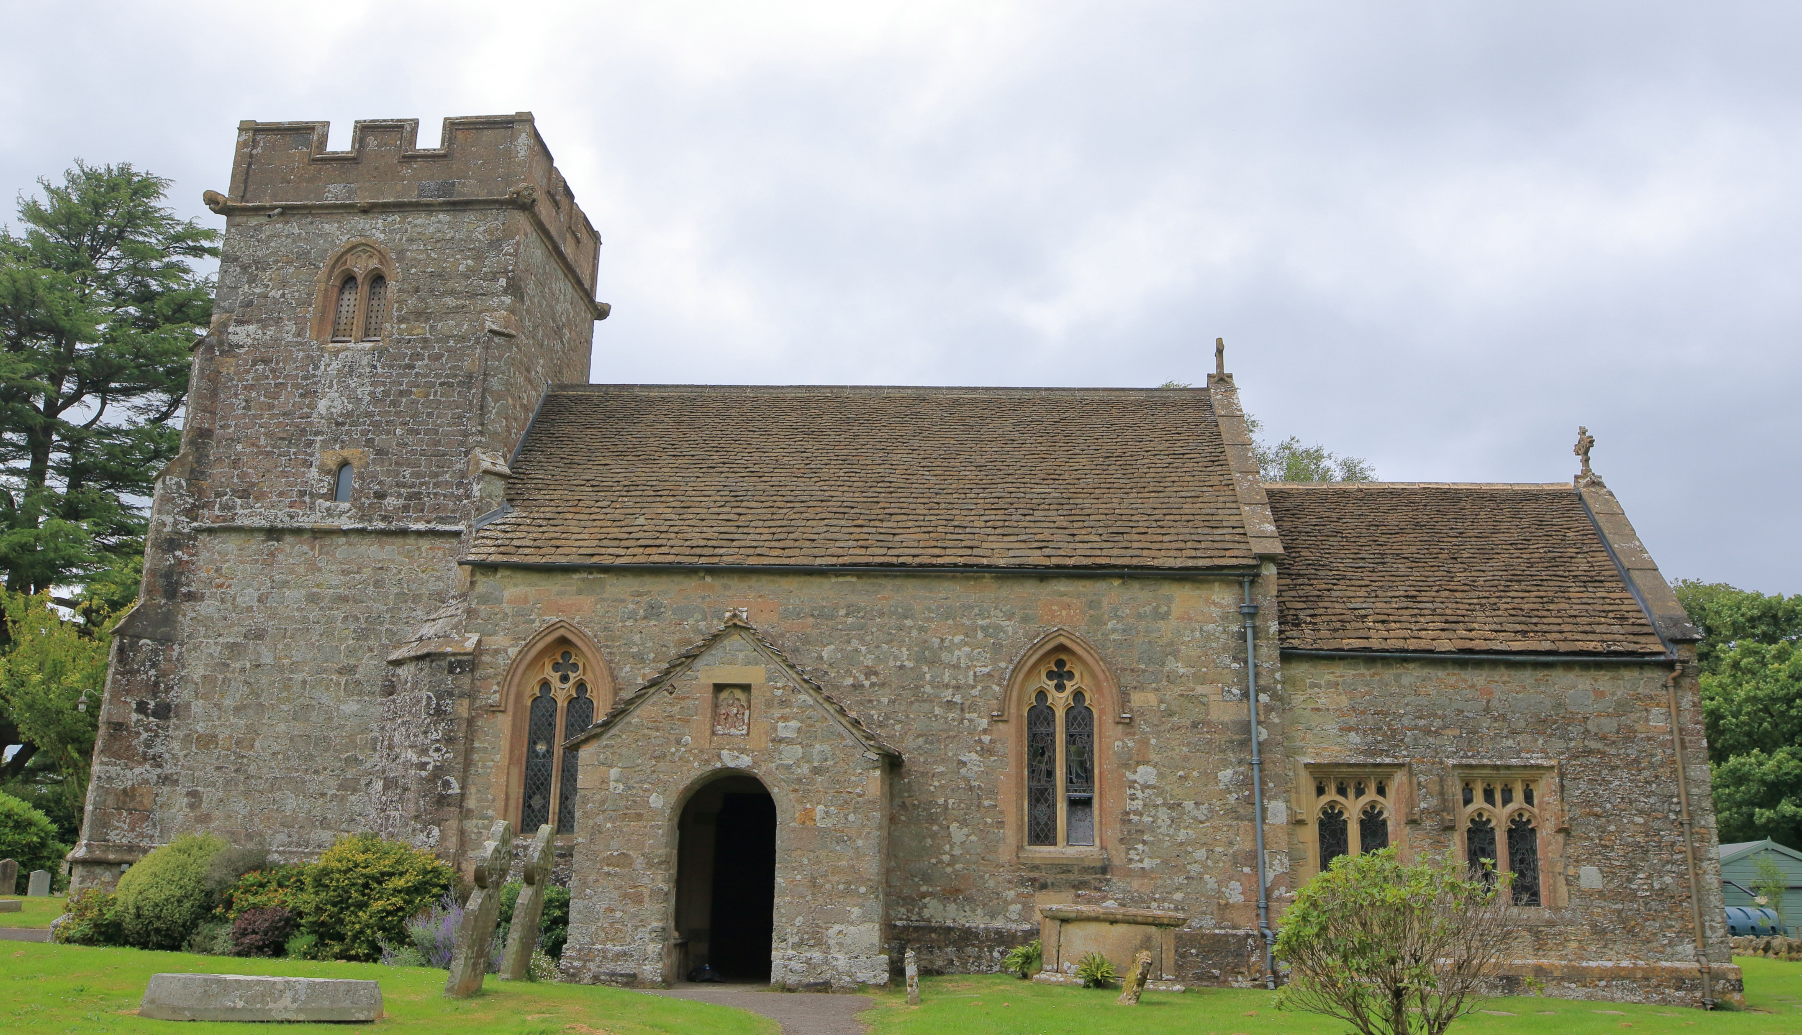
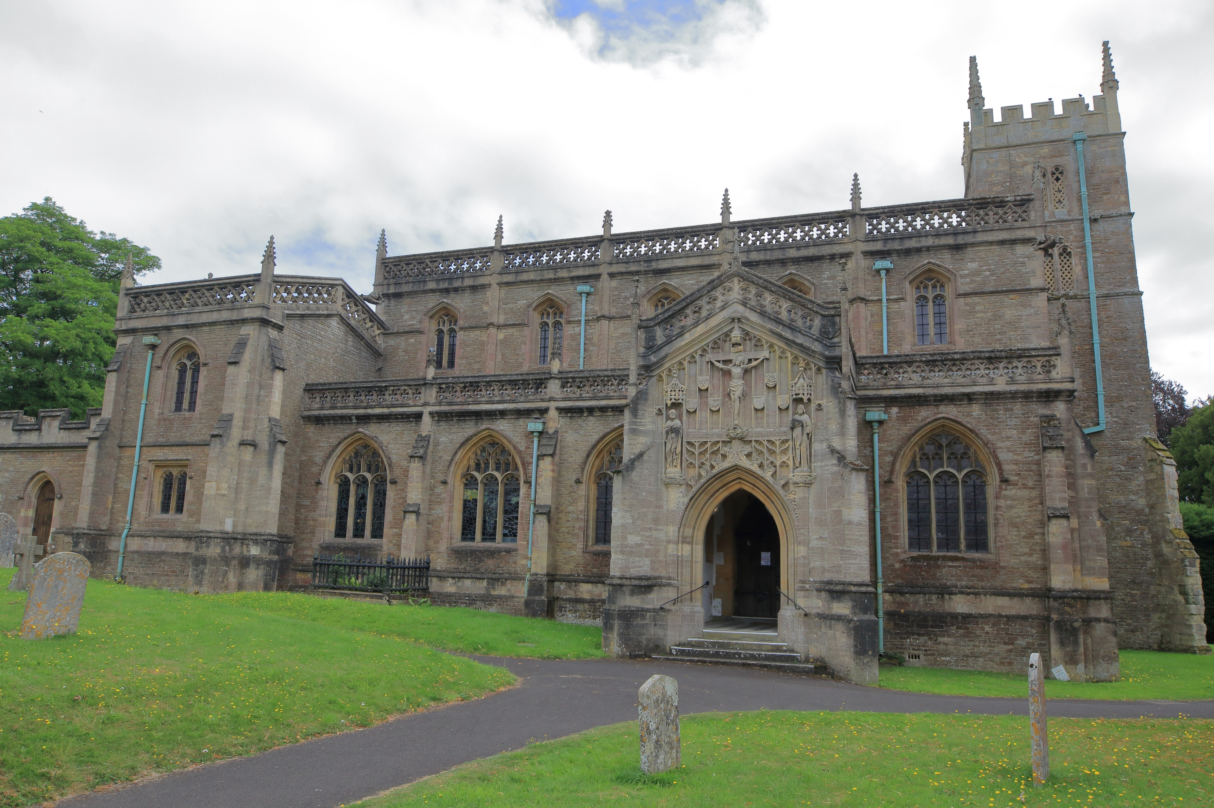
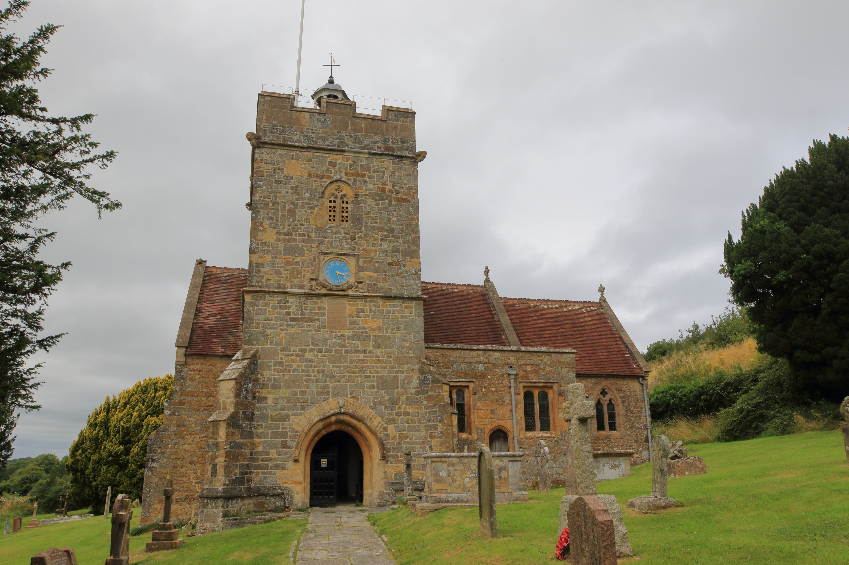
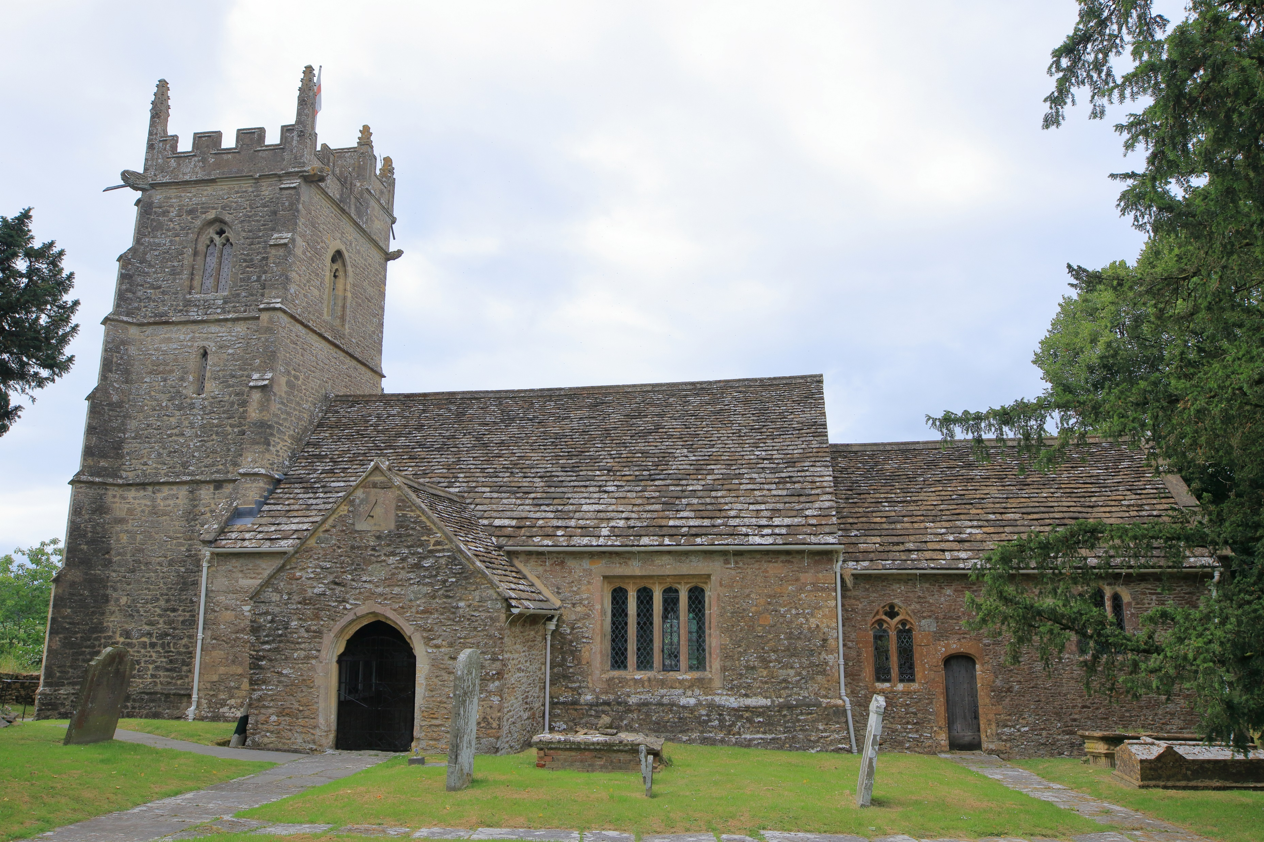
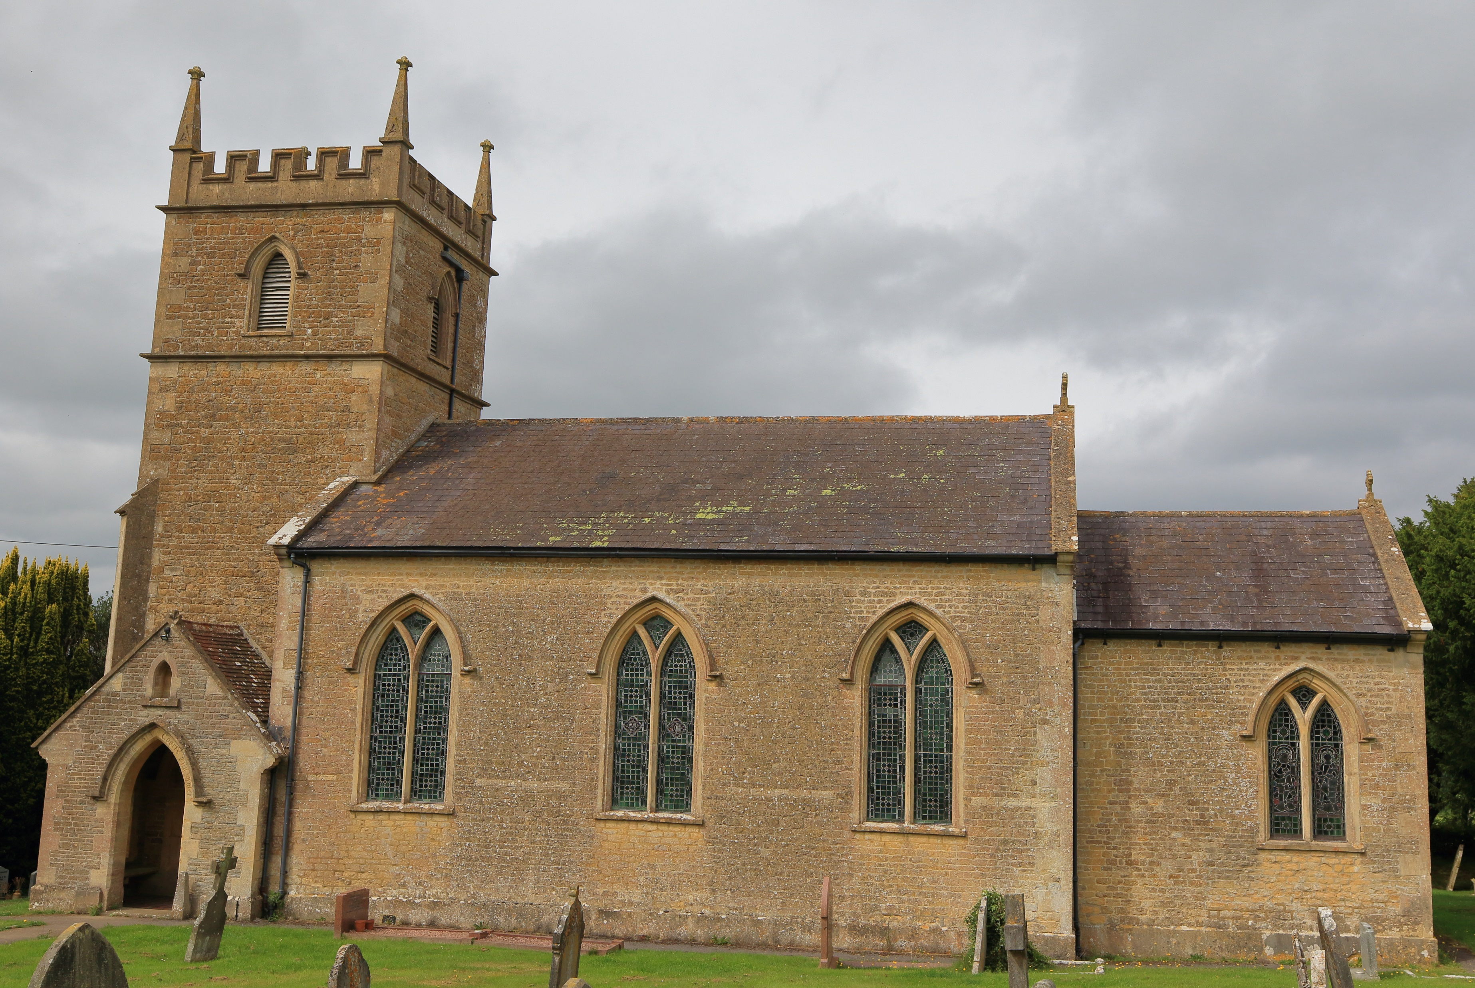
WORSHIP PLAN – MAY 2026
Sunday 3rd May
9am Rise & Shine Family Service St Michael’s Church, Pen Selwood
9am Holy Communion St Lawrence’s Church, Cucklington
10am Café Church St John’s Church, Charlton Musgrove
10:30am Holy Communion St Peter & St Paul’s Church, Wincanton
Sunday 10th May
9am Holy Communion St Stephen’s Church, Charlton Musgrove
9am Holy Communion St Michael’s Church, Pen Selwood
10:30am Morning Worship St Peter & St Paul’s Church, Wincanton
6:30pm Evening Service St Lawrence’s Church, Cucklington (Sung)
Thursday 14th May
7pm Deanery Ascension Day Service at St Mary’s Church, Bruton – all welcome.
Sunday 17th May
9am Morning Service St Michael’s Church, Pen Selwood
9am Holy Communion St Lawrence’s Church, Cucklington
10:30am Morning Praise St John’s Church, Charlton Musgrove
10:30am Holy Communion St Peter & St Paul’s Church, Wincanton
Sunday 24th May
10:30am Whole Benefice Communion – St Michael’s Church, Pen Selwood
Sunday 31st May
10:30am Whole Benefice Morning Worship – St Lawrence’s Church, Cucklington
For more information contact office@wincantonparishchurch.co.uk
01963 824503

